Slide 1






Group Project 1
Vik Shah, David Cheung, Sak Qasse

Slide 2
Agenda
Qasse – Influencers on uber price?
Vik – Influencers on uber demand?
David – Influencers on uber competition?

Slide 3

Uber rides analysis

Slide 4

Purpose of project
To understand how most riders use uber throughout weeks.
Uber’s ride price is not constant like public transport .
The factors that affected by the demand and supply of uber.
Is their correlation between the distance between price .

Slide 5

Cleaning and filtering the data
Drop empty rows
Convert epoch time to daytime
Filter the data since we are looking uber data only.

Slide 6
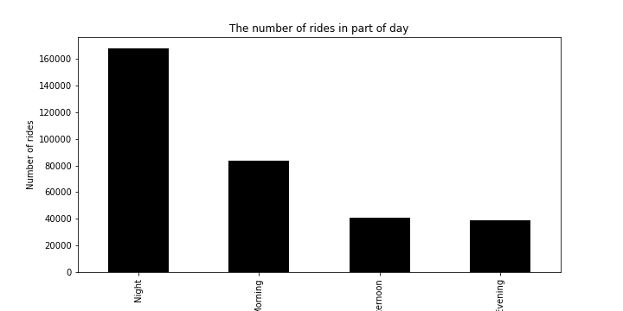
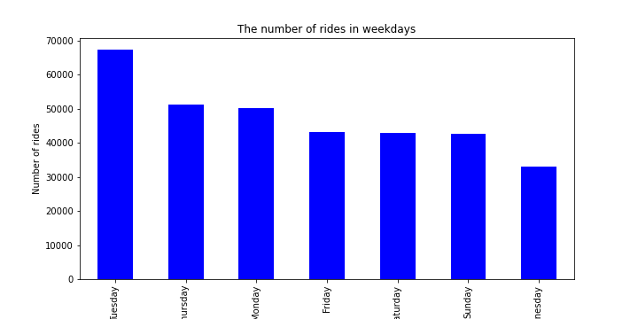
Which day has the most pickup?

Slide 7
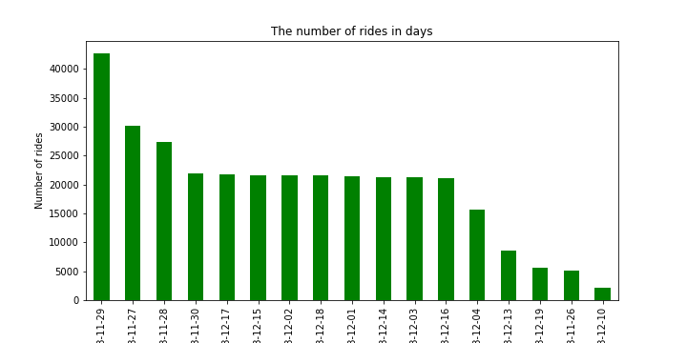
which date has the most pickup?

Slide 8
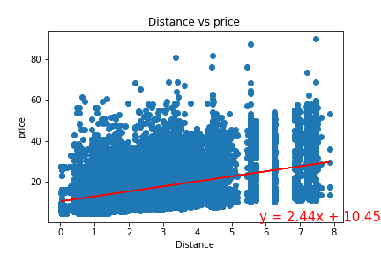
Linear regression

Slide 9

Limitation
Google Api’s
Data set.

Slide 10




Influencers on uber demand?
Dates or Days
Weather Conditions
Location of Pickups

Slide 11

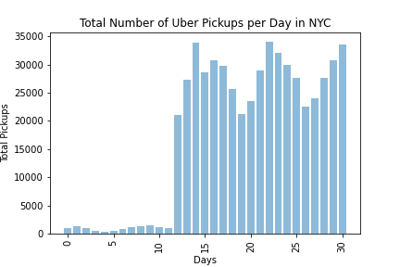
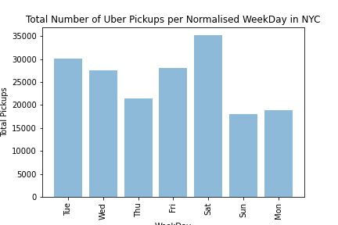
Dates or Days influence on uber demand?
Dates – summer holidays & public holiday (4th Jul)
Days – Saturdays e.g., going out / alcohol consumption
Days – Sundays e.g., staying in / tired / work week
Days – Mid-week e.g., cheap flights

Slide 12

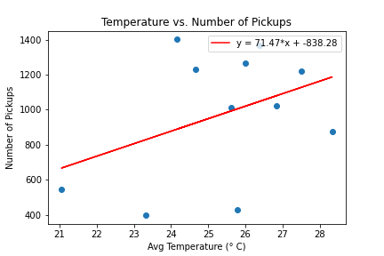
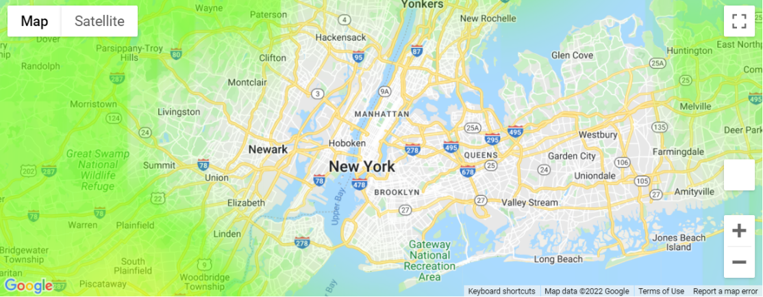

Weather influence on uber demand?
Temperature influence not the strongest correlation
Rain influence even weaker correlation – it’s summer…

Slide 13

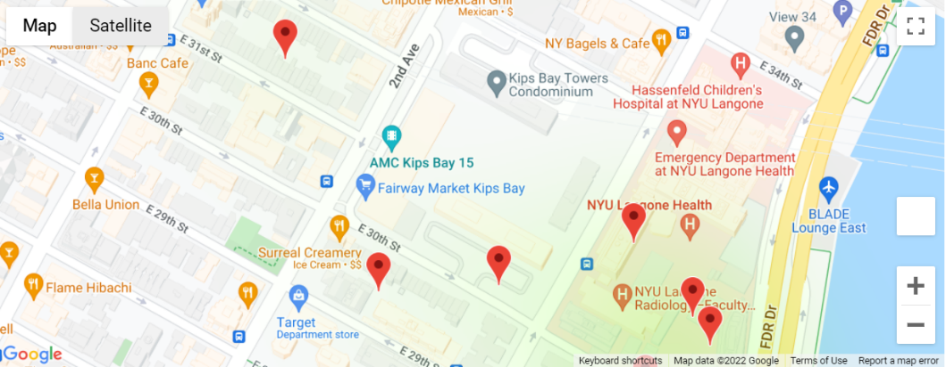
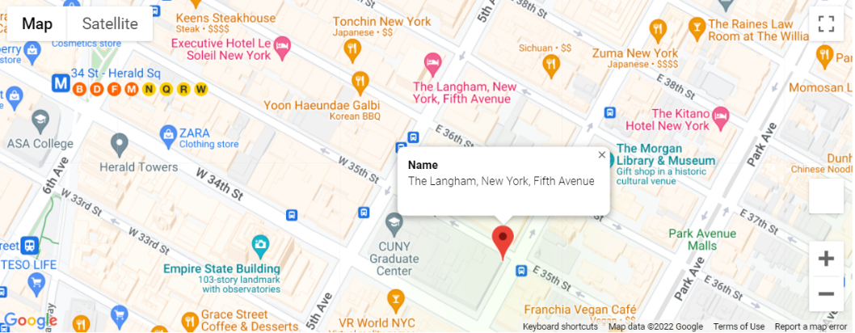
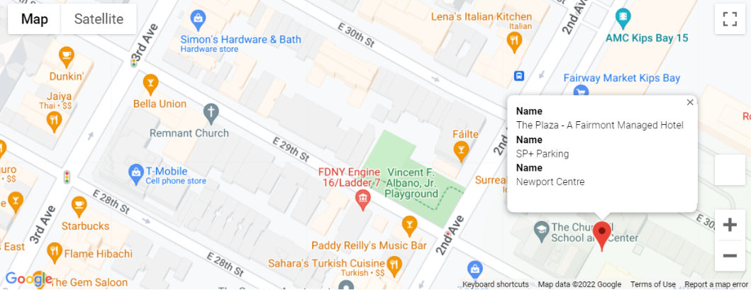
Location of Pickups influence on uber demand?
No airports, there is a hospital
“Uber is quicker than an ambulance”
Nearby Shopping Mall, Hotel, Parking Lot

Slide 14
Location of Pickups influence on uber demand?
No airports, there is a hospital
“Uber is quicker than an ambulance”
Nearby Shopping Mall, Hotel, Parking Lot

Slide 15
Location of Pickups influence on uber demand?
No airports, there is a hospital
“Uber is quicker than an ambulance”
Nearby Shopping Mall, Hotel, Parking Lot

Slide 16
Location of Pickups influence on uber demand?
No airports, there is a hospital
“Uber is quicker than an ambulance”
Nearby Shopping Mall, Hotel, Parking Lot

Slide 17
Location of Pickups influence on uber demand?
No airports, there is a hospital
“Uber is quicker than an ambulance”
Nearby Shopping Mall, Hotel, Parking Lot

Slide 18


Influencers on uber demand?
Days or Dates
Weather Conditions
Location of Pickups

Slide 19
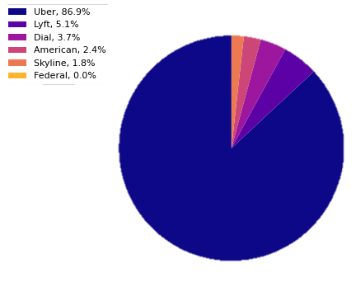
Uber vs Competition
Uber
Lyft
Dial
American
Skyline
Federal
(Federal data will not show as it does not contain individual ride data!)
For the purpose of demonstration
*The data that we received may not be able to judge as data from other providers were not as consistent.

Slide 20
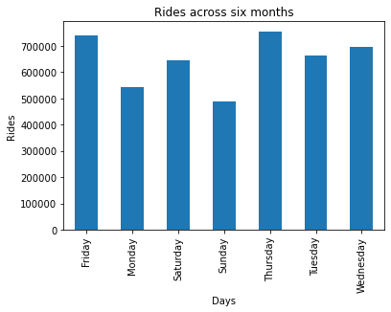
Uber data by themselves
Here, we look at Uber Data between April 2014 and September 2014
Spliting them up per weekdays
We see that the rides during weekdays are much more compared to the weekends (Saturday and Sunday)
The only day would be Monday vs Saturday
Varying reasons to results (Monday blues?)
This raises questions as to what do people mainly use uber for in New York City

Slide 21
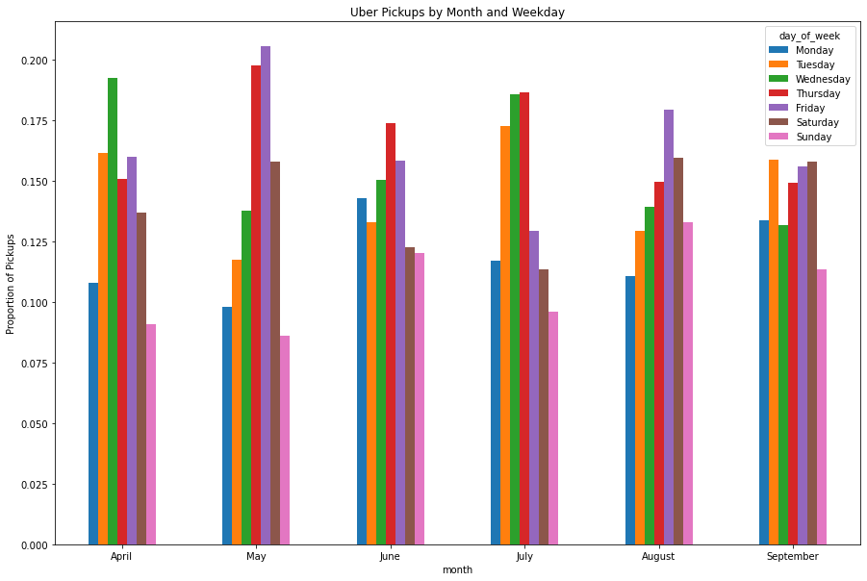
More: Uber Data Pickups during the week across the six months

Slide 22
Thank YOu

